Slide 1

Binomial Model Tree in MATLAB
The binomial model tree is a powerful tool for pricing and analyzing options in finance. It provides a flexible and intuitive way to model the evolution of an asset's price over time using a discrete-time approach.

Slide 2
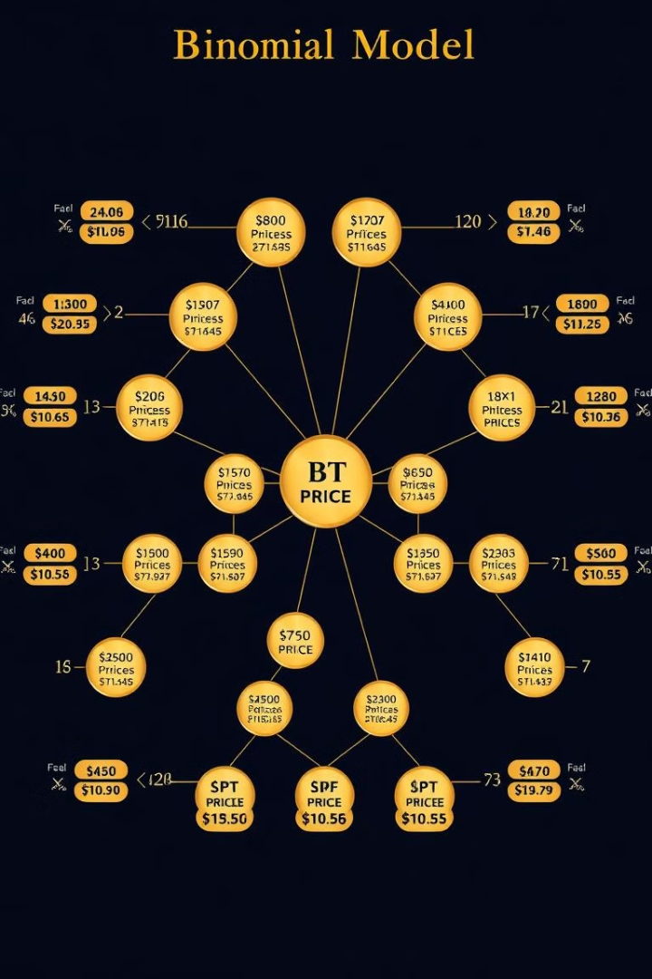
What is a Binomial Model Tree?
1
Discrete-Time Model
2
Price Movements
The binomial model tree divides the time period into discrete steps, typically one day or one week.
At each step, the asset price can either increase by a certain factor or decrease by another factor.
3
Probabilities
The model assigns probabilities to the up and down movements, allowing for the calculation of expected values.

Slide 3
Advantages of Binomial Model Tree
Flexibility
Intuitive Understanding
Computational Efficiency
The binomial model can be easily adapted to different types of options and underlying assets.
The graphical representation of the price paths makes the model easy to understand and explain.
Compared to other numerical methods, the binomial model is relatively simple and computationally efficient.

Slide 4
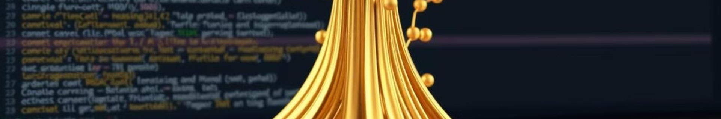
Implementing Binomial Model Tree in MATLAB
Set Parameters
Price the Option
Define the underlying asset price, volatility, risk-free rate, and time to expiration.
Recursively calculate the option value at each node in the tree, working backward from expiration.
1
2
3
Build the Tree
Construct the binomial tree by calculating the up and down factors and the risk-neutral probabilities.

Slide 5
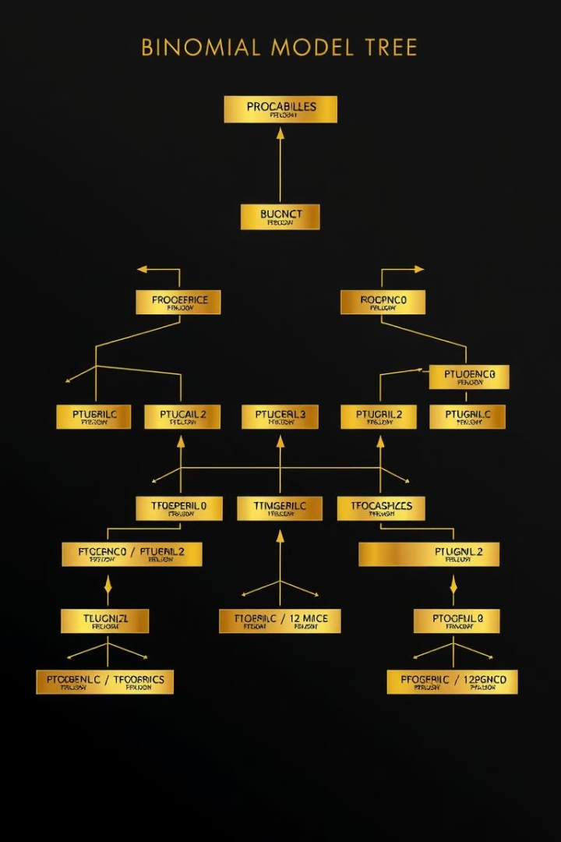
Constructing the Binomial Tree
Up Factor
Down Factor
Calculated based on the asset volatility and time step.
Calculated as the reciprocal of the up factor.
Risk-Neutral Probabilities
Recursive Calculations
Option values are computed by working backward from the expiration date.
Determined using the risk-free rate and the up and down factors.

Slide 6




Pricing Options using the Binomial Tree
Call Options
The model can be used to price European and American call options.
Put Options
The model can also be used to price European and American put options.
Underlying Asset
The binomial model can be applied to a wide range of underlying assets, such as stocks, commodities, and currencies.

Slide 7
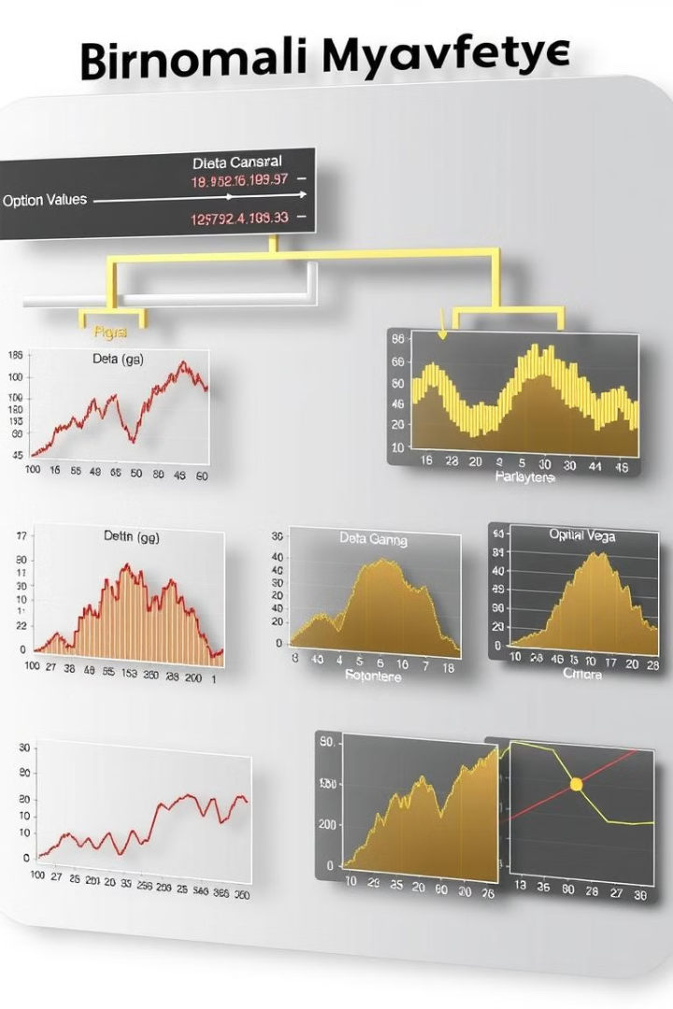




Sensitivity Analysis and Greeks
Delta
Measures the sensitivity of the option price to changes in the underlying asset price.
Gamma
Measures the sensitivity of the delta to changes in the underlying asset price.
Vega
Measures the sensitivity of the option price to changes in the underlying asset volatility.
Theta
Measures the sensitivity of the option price to changes in the time to expiration.

Slide 8
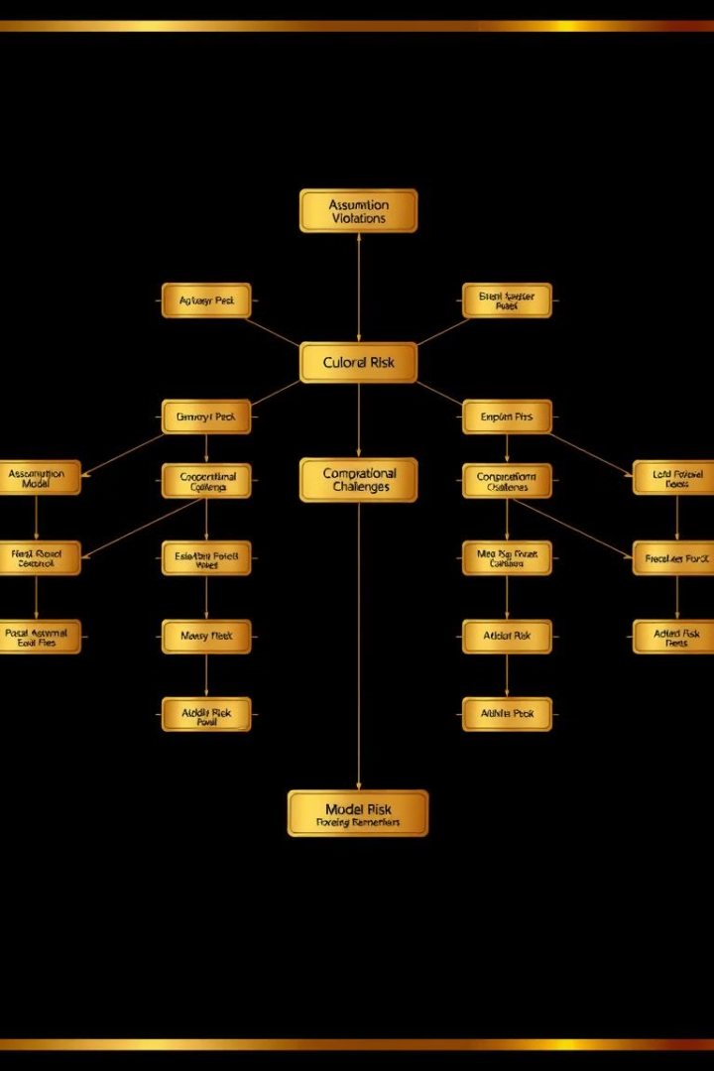
Limitations and Considerations
Assumption Violations
The model assumes constant volatility and risk-free rate, which may not always hold true.
Computational Complexity
As the number of time steps increases, the computations can become more complex.
Model Risk
The accuracy of the model depends on the quality of the input parameters and assumptions.

Slide 9

Conclusion and Key Takeaways
1
Flexibility and Intuition
2
Computational Efficiency
The binomial model provides a flexible and easy-to-understand approach to options pricing.
The model is relatively simple to implement and computationally efficient compared to other numerical methods.
3
Sensitivity Analysis
4
Limitations and Considerations
The model enables in-depth sensitivity analysis and the calculation of important Greeks.
Users should be aware of the model's assumptions and potential limitations when applying it in practice.

